Slide 1
Installation and setup Behat in windows

Slide 2
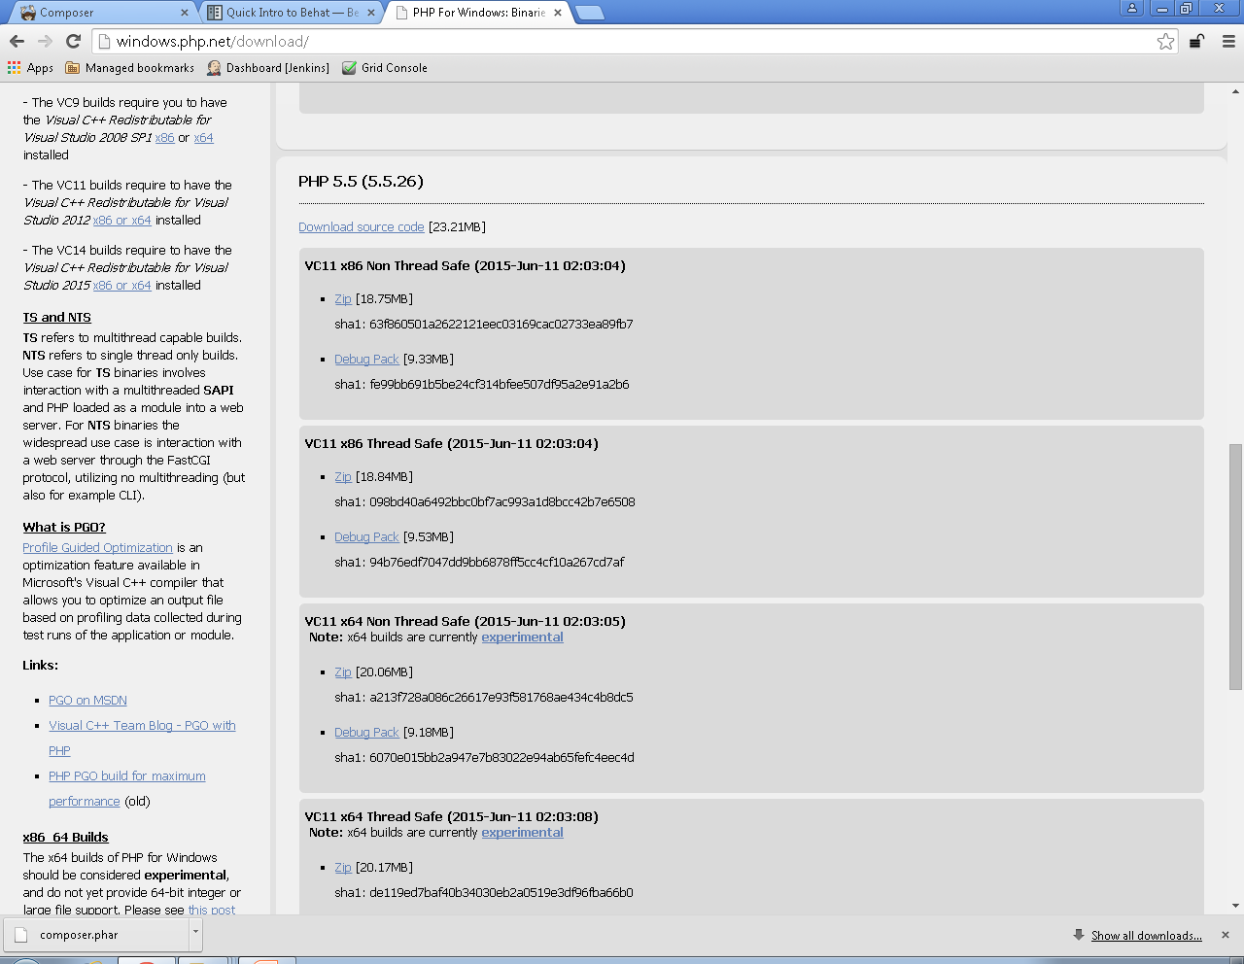
download php 5.5
navigate to http://windows.php.net/download/
go to section as shown in next screen.
download zip files under section
into C: drive of your computer and name folder as php.
VC11 x86 Non Thread Safe ( for 32 bit system )
VC11 x64 Non Thread Safe ( for 64 bit system )
move to php folder and copy file ‘php.ini-production’ and rename new file as ‘php.ini’

Slide 3
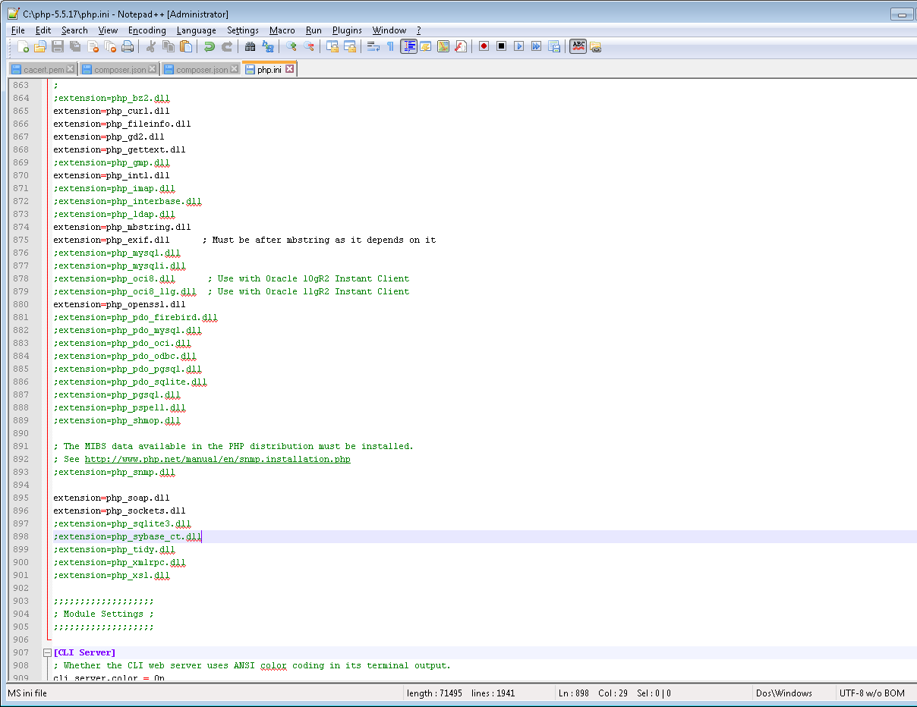
In php.ini file make below changes as mentioned in below.
Uncomment lines. [ i.e. remove semicolon at start of line in file]
extension_dir = "ext“
extension=php_curl.dll
extension=php_fileinfo.dll
extension=php_gd2.dll
extension=php_gettext.dll
extension=php_intl.dll
extension=php_mbstring.dll
extension=php_exif.dll ; Must be after mbstring as it depends on it
extension=php_openssl.dll
extension=php_soap.dll
extension=php_sockets.dll
Also check below line is present
allow_url_fopen = On

Slide 4
Add php.exe folder path in environment variable
check if php is installed correctly on machine using command
php –v
command should return which version is installed.
create a working directory on D drive of your machine, name it as ‘behat’ or anything as you need.
inside directory create another file and name it compulsarily as ‘composer.json’
this file contains all libraries required for working of behat. Open it and add first one as in below JSON format only.
{
"require": {
"behat/behat": "~2.5"
},
"config": { "bin-dir": "bin/"
}
}
save and close file.
Note: verify above json format in
http://jsonformatter.curiousconcept.com/ OR
http://jsonlint.com/

Slide 5
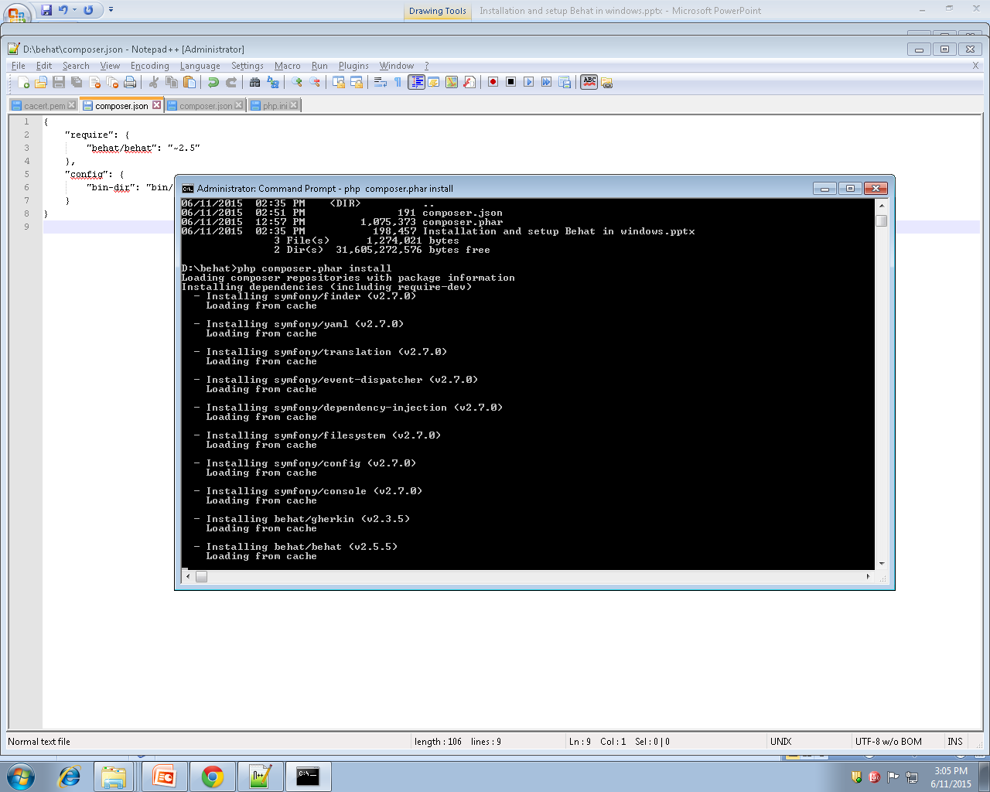
go to https://getcomposer.org/download/ and check latest link in Manual download section.
download latest composer.phar file. [1.0.0-alpha10 ] from there.
save file in working directory created in earlier steps.
open command line from working directory and run below command to install behat
php composer.phar install
following output should appear for you.

Slide 6
after finishing behat download we need to download other libraries like
selenium2 webdriver and mink and mink extension which facilitates us to use ready made statement which deals with browser.
Use below command one by one and install libraries as did in last step.
behat is already install so no need to install that library .
php composer.phar require behat/mink:1.5.0
php composer.phar require behat/mink-goutte-driver:*
php composer.phar require behat/mink-selenium-driver:1.1.0
php composer.phar require behat/mink-selenium2-driver:1.1.1
php composer.phar require behat/mink-extension:1.3.3
php composer.phar require drupal/drupal-extension:1.0.9
Note: you may need to register on below links for downloading.
https://github.com/
https://packagist.org/
Or you may need corp credentials.

